Slide 1

AI-Powered Business Intelligence Agent
Subject: MGNM521 – Disruptive Technologies
Subash R - 12500554
Faculty Name – Dr. Arun Khatri
07/05/2026

Slide 2
Problem Statement
Organizations receive massive amounts of customer feedback through reviews and social media. Manual analysis is inefficient and does not provide real-time business intelligence.
Objectives:
Develop an AI-powered system that:
Analyzes customer sentiment
Identifies complaints and strengths
Generates business insights
Provides chatbot interaction
Visualizes trends using Power BI or Python

Slide 3
Dataset Description
Dataset Used: Amazon Fine Food Reviews Dataset.
Dataset Details:
10,000+ records
Review text
Product ID
Ratings (1–5)
Time-based review data
Preprocessing:
Removed null values
Text cleaning
Stopword removal
Sentiment labeling

Slide 4
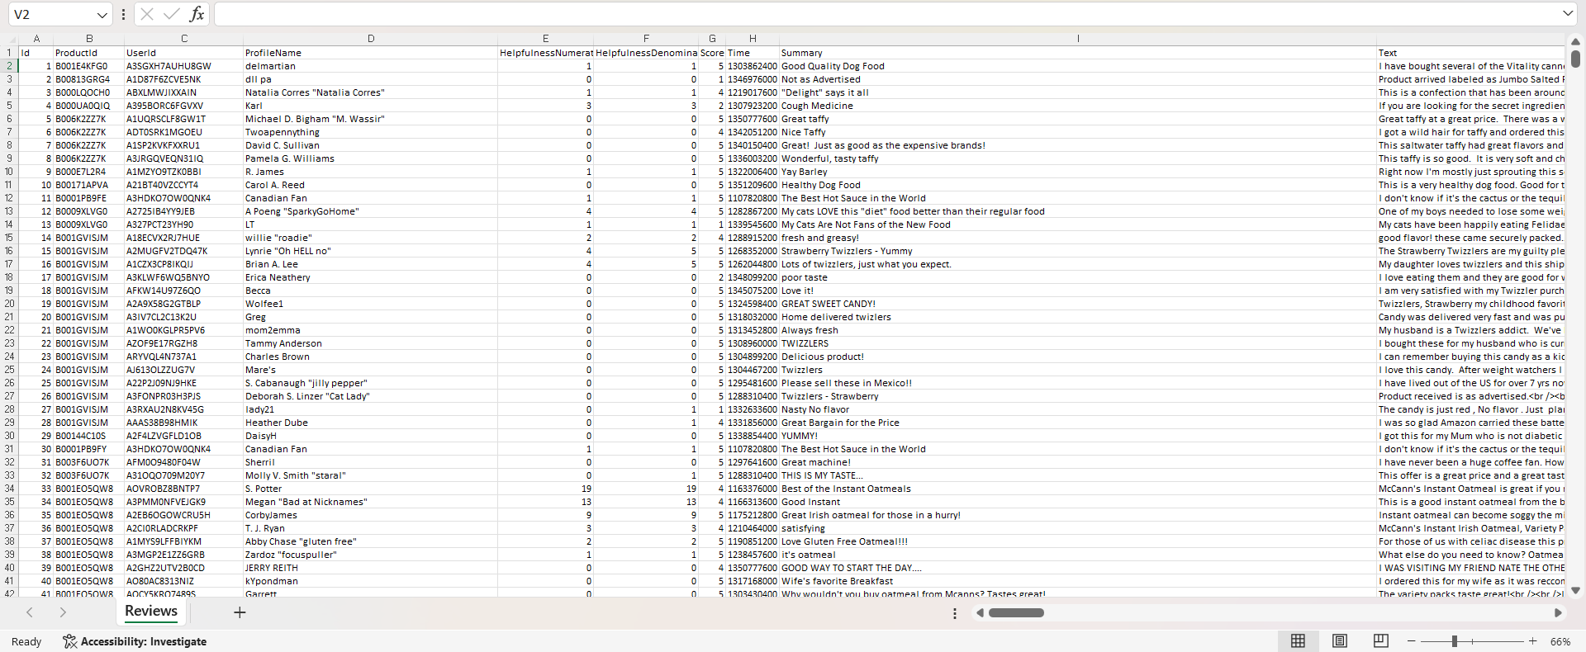
Snap of the Excel dataset:

Slide 5
System Architecture / Workflow
Dataset → Preprocessing → Sentiment Analysis → Insight Generation → Chatbot → Dashboard
Technologies Used:
Python
Pandas
TextBlob
NLTK
Tkinter

Slide 6
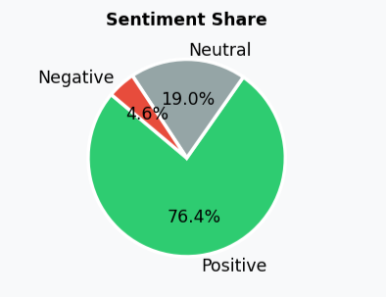
Sentiment Analysis Engine
NLP Sentiment Classification
The system classifies reviews into:
Positive
Negative
Neutral
Method Used:
TextBlob polarity analysis
Rule-based classification
Features:
Sentiment score generation
Trend analysis
Accuracy validation

Slide 7
Chatbot & BI Features
Business Intelligence Chatbot
Additional Features
The chatbot answers:
Overall sentiment
Top complaints
Customer satisfaction
Product performance
Predictive trends
Business recommendations
Why-analysis
Predictive forecasting
Actionable insights

Slide 8
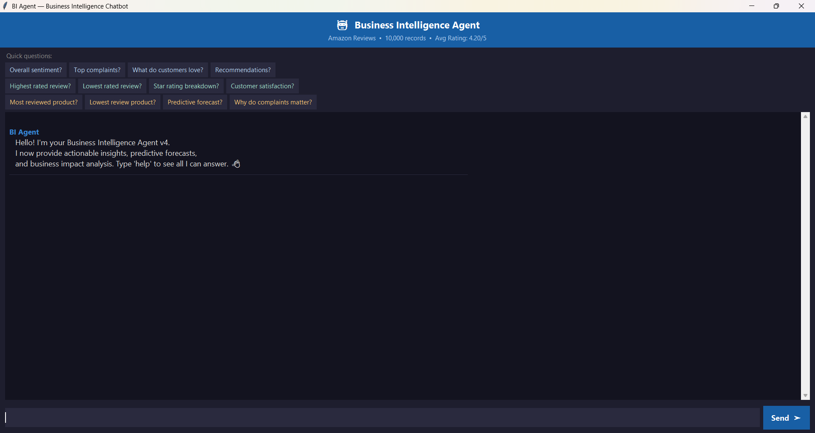
Snap of the chatbot screen

Slide 9
Dashboard
Dashboard Features
KPI’s
KPI cards
Sentiment distribution
Trend analysis
Product analysis
Rating distribution
Business insight panel
Positive %
Negative %
CSAT
Average Rating

Slide 10
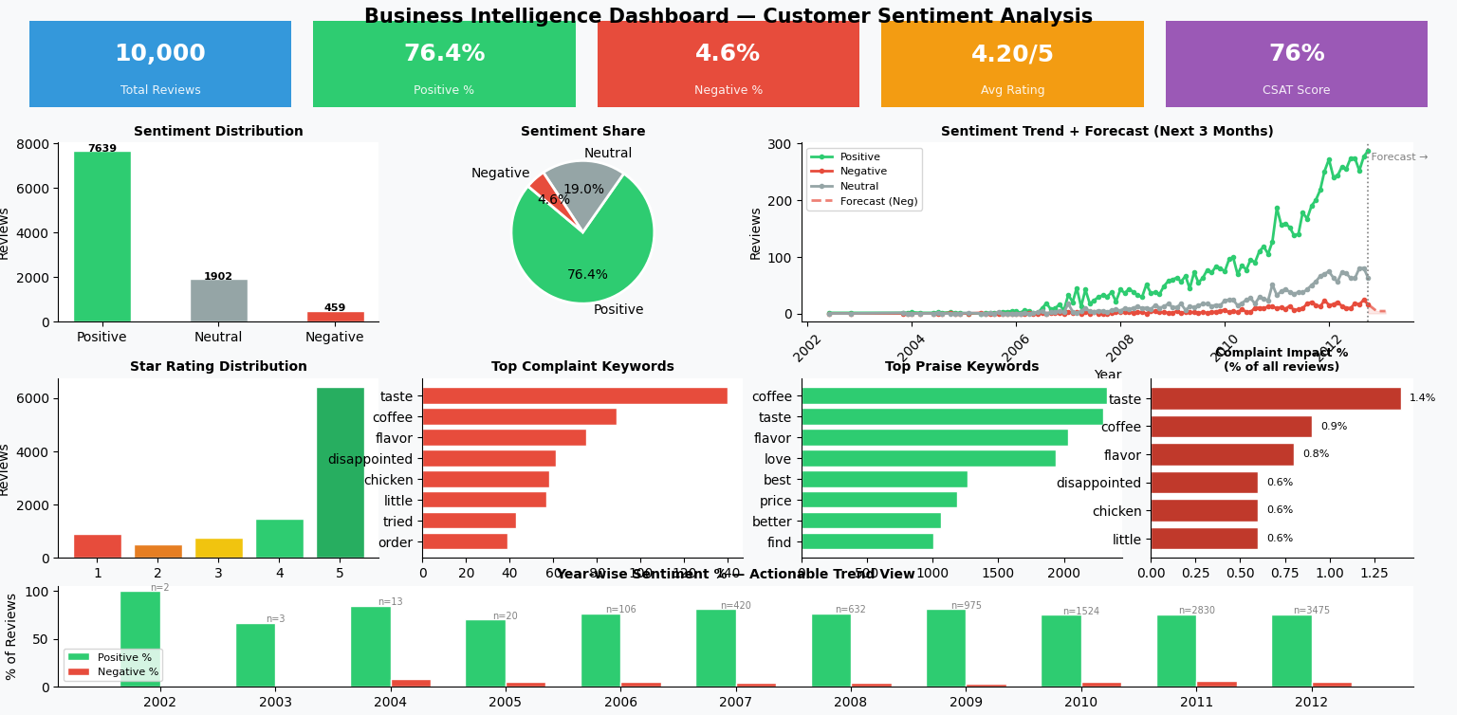
Snap of the dashboard

Slide 11
Key Insights & Findings
Key Findings:
Majority of reviews are positive
Main complaints:
Quality
Delivery
Packaging
Strong customer satisfaction observed
Trend Analysis:
Some periods show increased negative sentiment
Forecasting indicates future improvement/risk

Slide 12
Business Recommendations
Recommendations:
Improve product quality control
Optimize delivery logistics
Reduce packaging issues
Use positive reviews in marketing
Monitor sentiment continuously
Business Impact:
Increased customer satisfaction
Better retention
Improved decision-making

Slide 13
Conclusion
The AI-powered BI Agent successfully:
Analyzes customer feedback
Generates actionable insights
Supports business decision-making
“AI transforms raw customer feedback into strategic business intelligence.”

